Slide 1
MACHINE LEARNING
Session – 5
Date – 22nd May, 2022

Slide 2
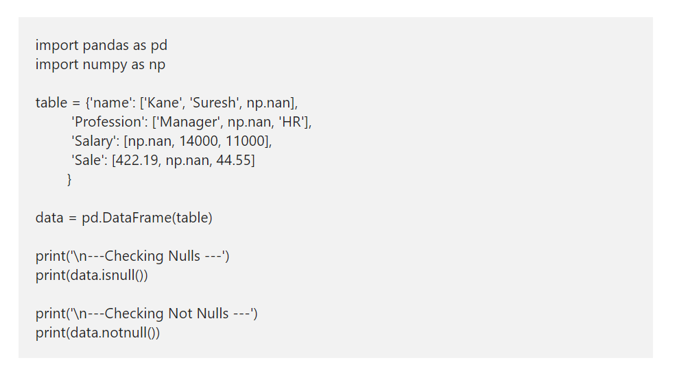
Python Pandas DataFrame Nulls
The isnull check and returns True if a value in data frame is Null otherwise False. Pandas notnull function returns True if value is not Null otherwise, False is returned.

Slide 3
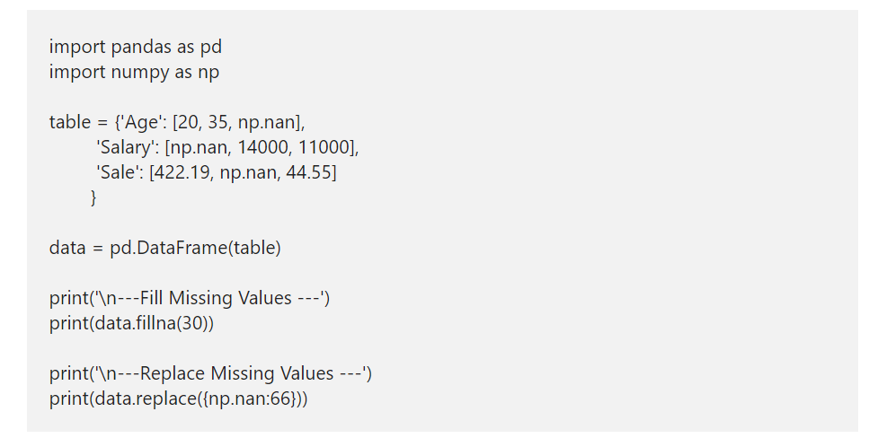
Replace Nulls
We can also replace those Null values with a meaningful numbers. So, to replace nulls in pandas, use Python DataFrame fillna function or replace function.

Slide 4
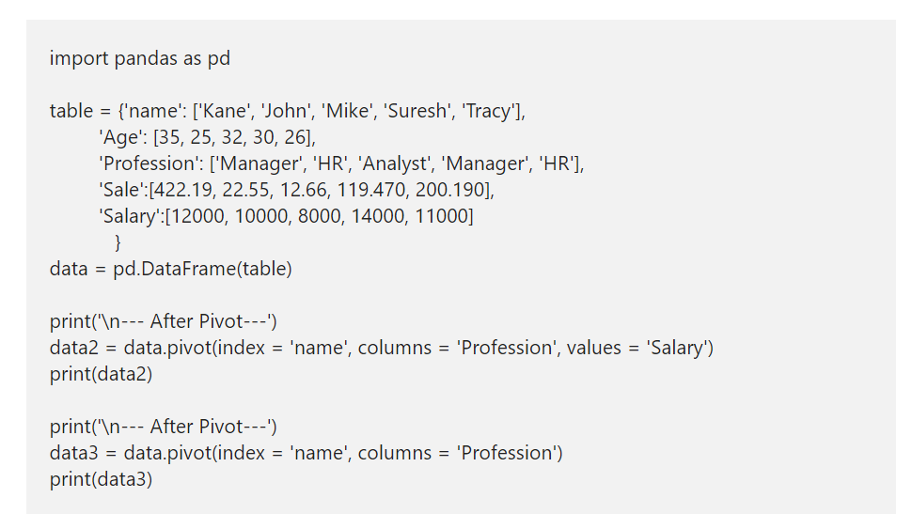
Pandas DataFrame pivot
Convert Row to Column

Slide 5
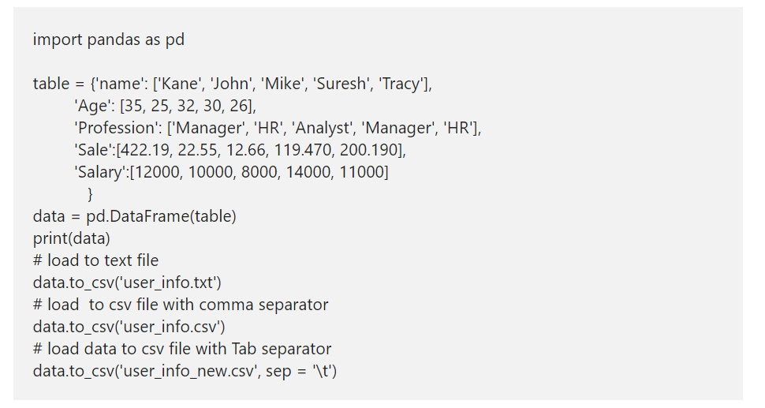
How to save DataFrame to CSV and Text File?

Slide 6
CHARTS

Slide 7
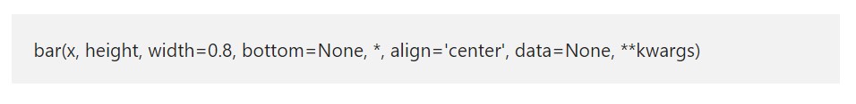
Python matplotlib Bar Chart
A Python Bar chart, Plot, or Graph in the matplotlib library is a chart that represents the categorical data in a rectangular format. By seeing those bars, one can understand which product is performing good or bad. It means the longer the bar, the better the product is performing. In Python, you can create both horizontal and vertical bar charts using this matplotlib library and pyplot.
The Python matplotlib pyplot has a bar function, which helps us to create this chart or plot from the given X values, height, and width. The basic syntax of the Python matplotlib bar chart is as shown below.

Slide 8
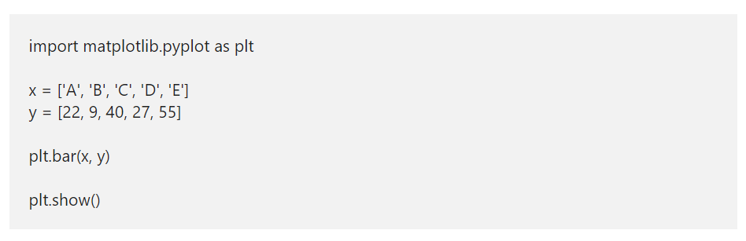
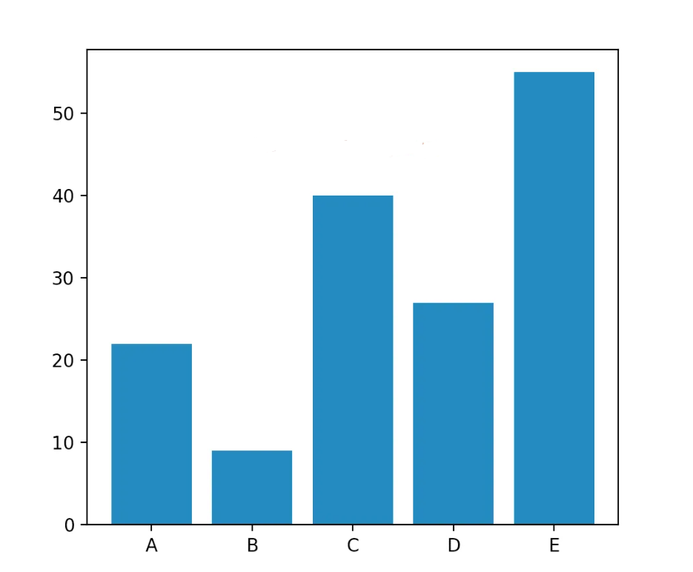
Create a Basic matplotlib bar chart in Python

Slide 9
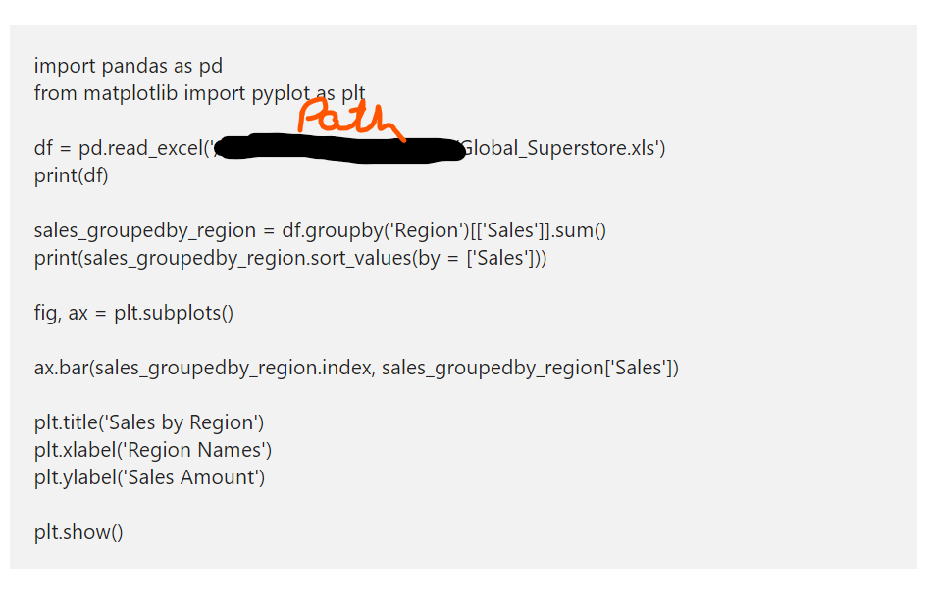
Python matplotlib Bar chart from CSV file

Slide 10
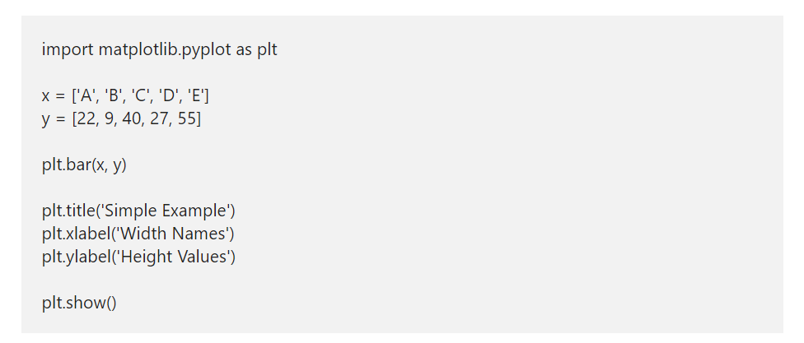
matplotlib bar chart names
The matplotlib bar plot has xlabel, ylabel, and title functions, which are useful to provide names to X-axis, Y-axis, and chart name.
xlabel: Assign your own name to X-axis. This function accepts a string, which assigned to the X-axis name.
ylabel: Use this function to assign a name to Y-axis
title: Please specify the chart name

Slide 11
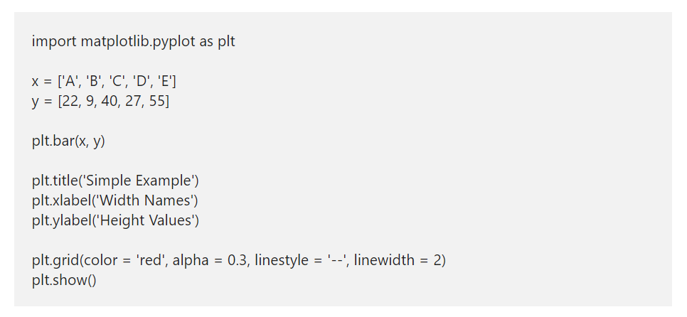
bar chart grid lines
supported values are '-', '--', '-.', ':', 'None', ' ', '', 'solid', 'dashed', 'dashdot', 'dotted'

Slide 12
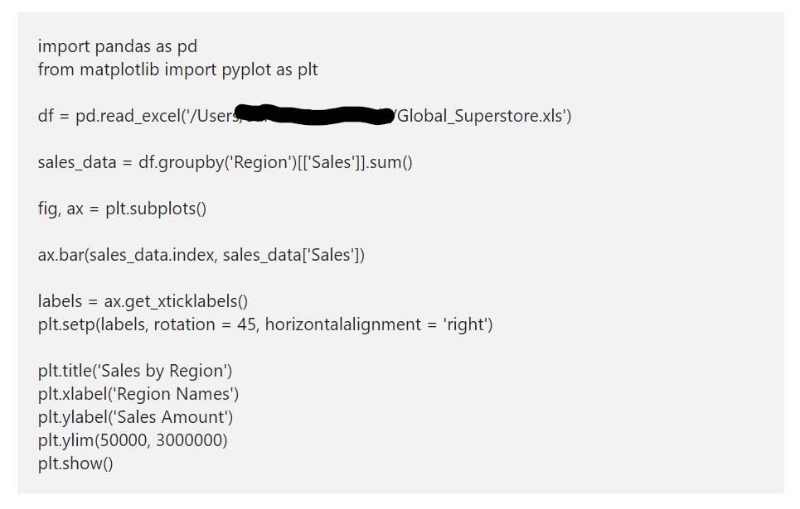
Limit Y-axis values of Python bar plot
There is a ylim method in pyplot bar function that will limit or change the y-axis values. Here, we changed the starting value from 0 to 50000 and end value from 2500000 to 3000000.

Slide 13
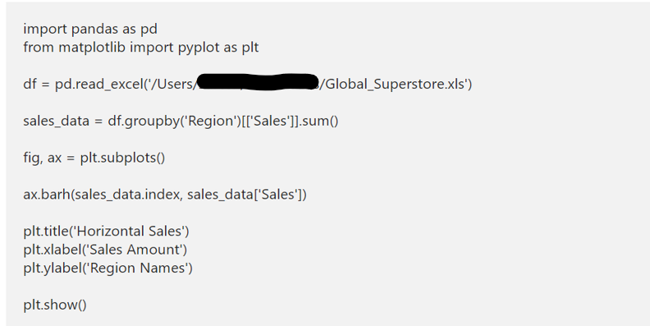
Python matplotlib Horizontal Bar Chart
The matplotlib library provides a barh function to draw or plot a horizontal bar chart in Python. In this example, we replaced the actual function with the barh function to draw a horizontal bar chart. Next, we changed the xlabel and ylabel to changes the axis names.

Slide 14
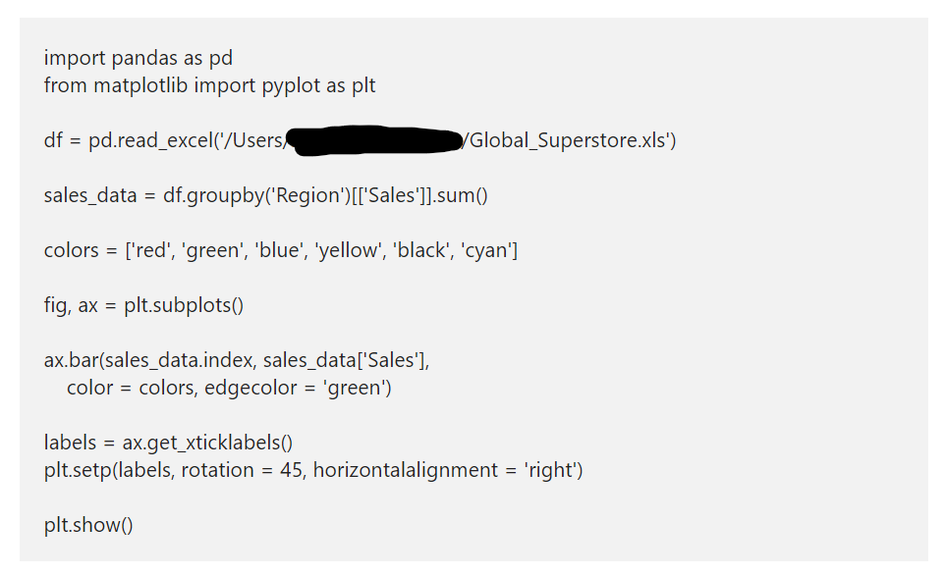
Python Bar Chart Colors

Slide 15
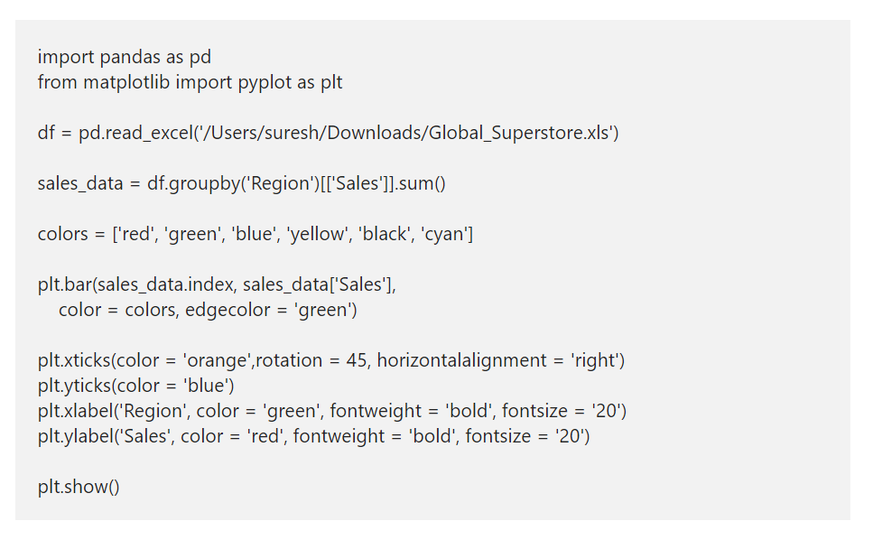
Format Axis Labels of a bar chart

Slide 16
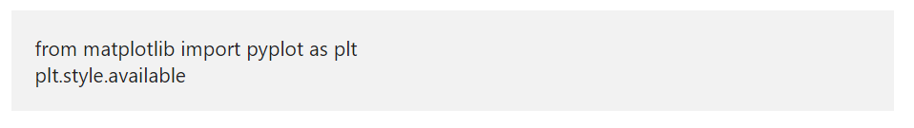
Styling Python matplotlib Bar chart
Use the below code to find out the list of available styles in pyplot.
plt.style.use('tableau-colorblind10')

Slide 17
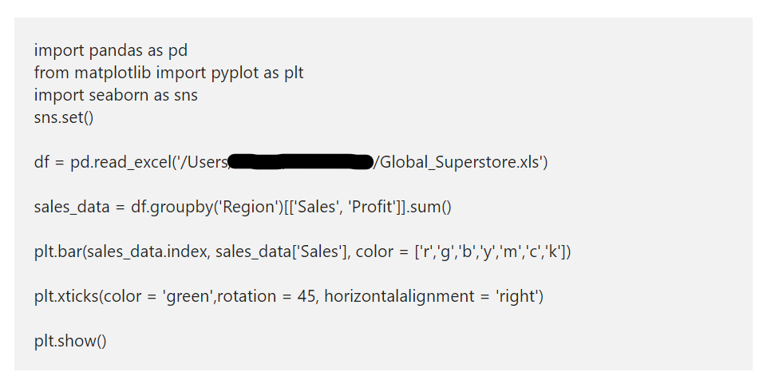
Seaborn

Slide 18
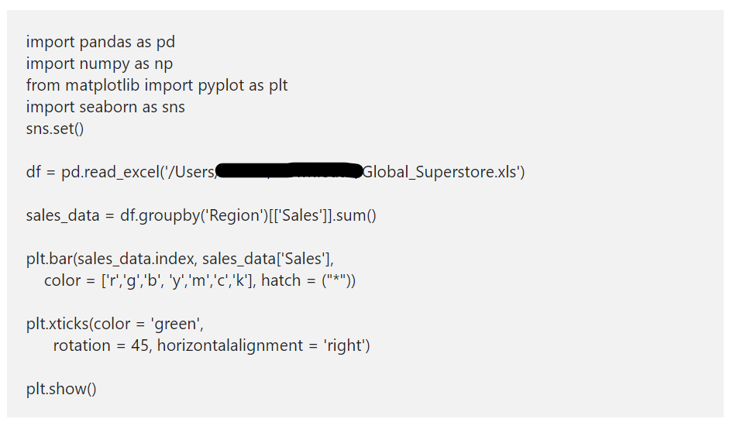
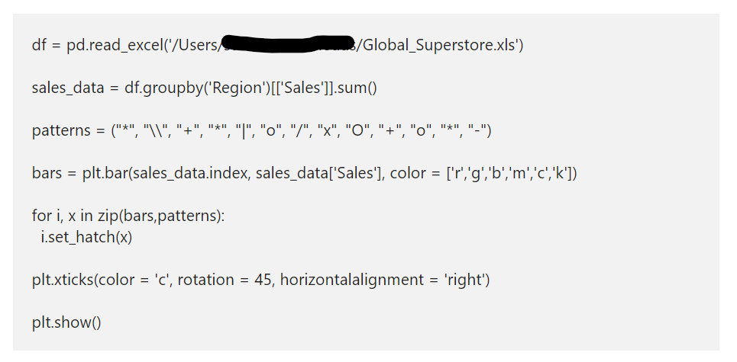
Change the matplotlib bar chart texture
In Python matplotlib bar chart, there is an argument called hatch to change the texture. Instead of filling the empty space, you can fill them with different patterns or shapes. For example, here, we will fill all the cylinders with * symbol.

Slide 19
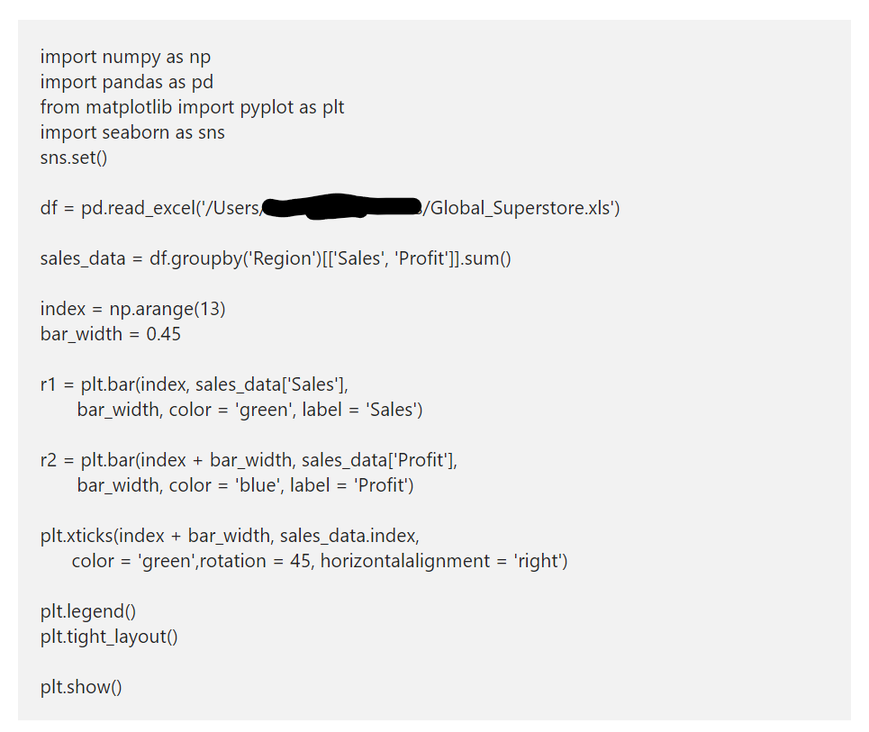
Plot two matplotlib Bar Charts in Python

Slide 20
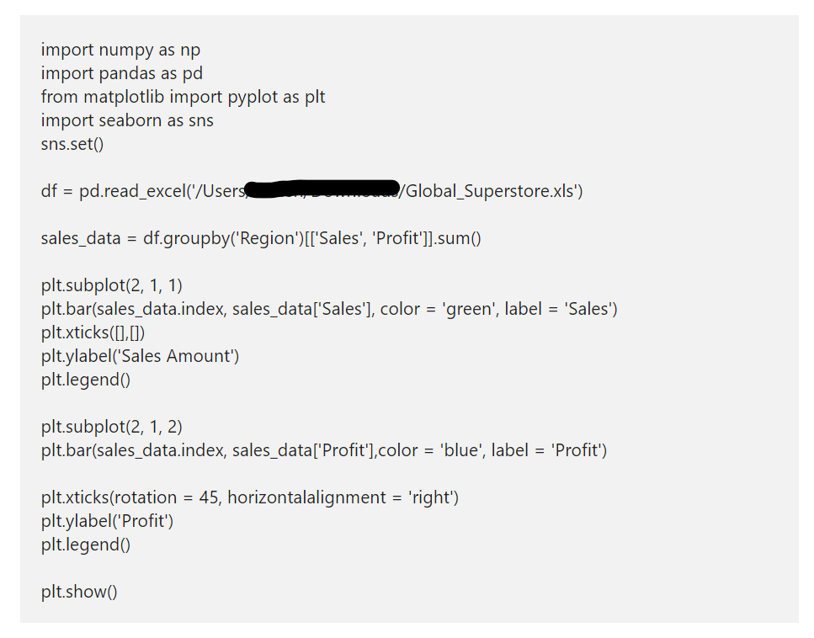
matplotlib Bar Chart subplots

Slide 21
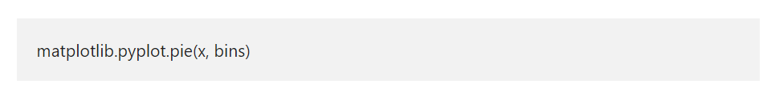
Python matplotlib Histogram
The Python matplotlib histogram looks similar to the pyplot bar chart. However, the data will equally distribute into bins. Each bin represents data intervals, and the matplotlib histogram shows the comparison of the frequency of numeric data against the bins.
In Python, you can use the Matplotlib library to plot histogram with the help of pyplot hist function. The hist syntax to draw matplotlib pyplot histogram in Python is

Slide 22
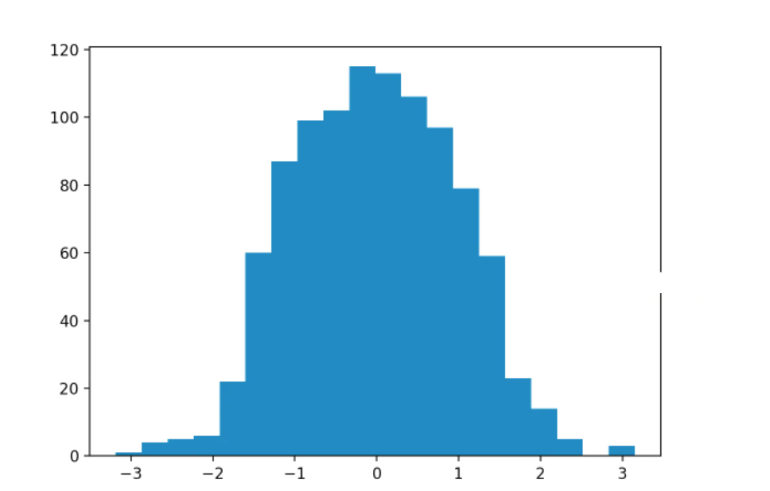
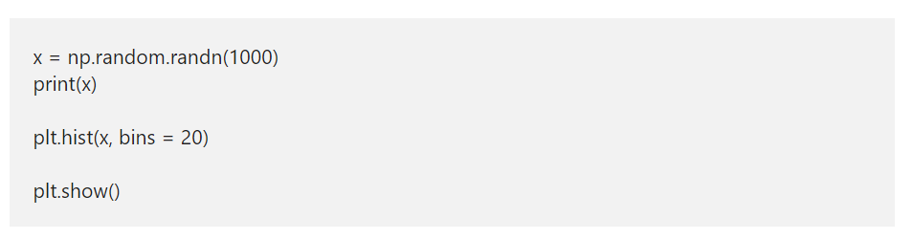
Simple matplotlib Histogram Example
Here, we used this argument number explicitly by assigning 20 to it. It means, below code will draw a hist of random numbers, and the data will equally distribute into 20 bins.

Slide 23
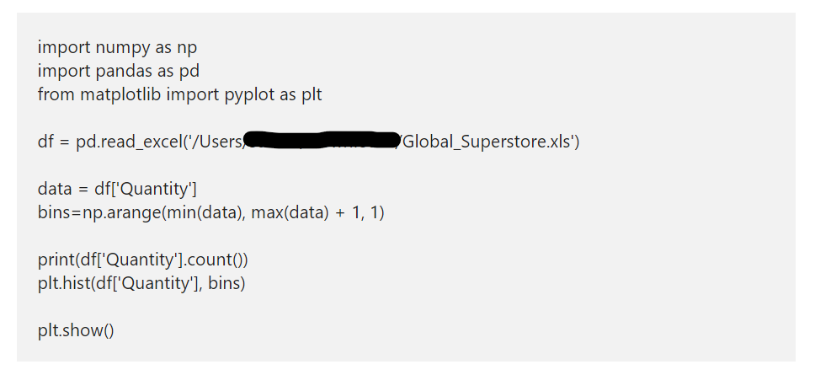
Python matplotlib Histogram using CSV File

Slide 24
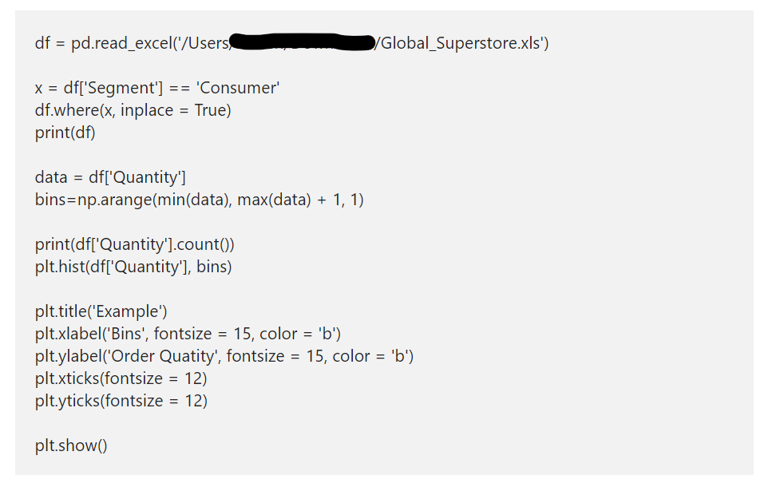
Python matplotlib Histogram titles
Plt.legend(sales_data.index, loc = ‘upper right’)

Slide 25
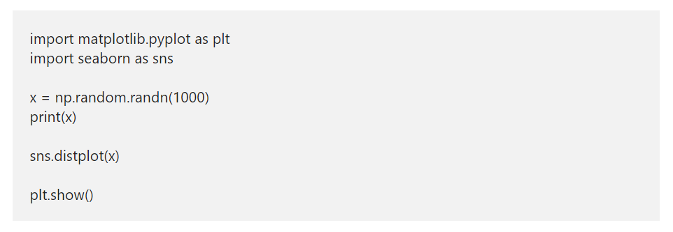
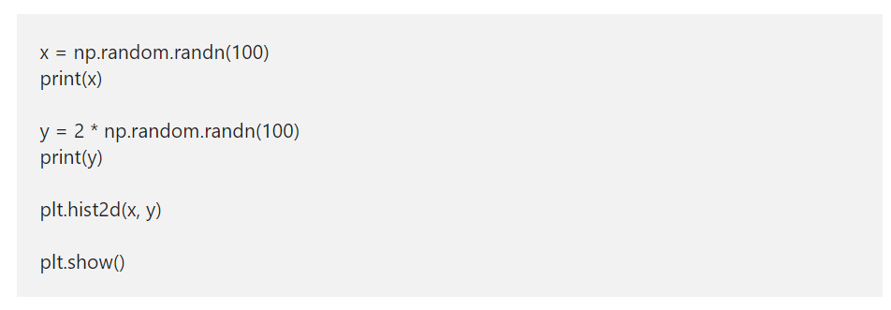
Python matplotlib seaborn Histogram
2D Histogram

Slide 26
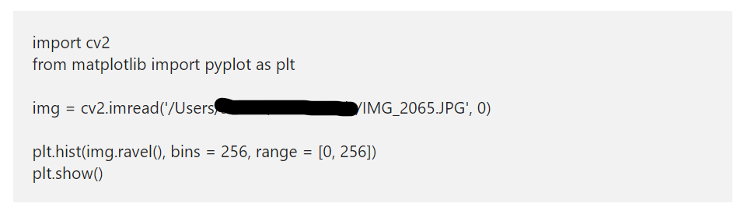
Python matplotlib Histograms of an Image
Apart from the above-specified ones, you can use the Python Matplotlib histograms to analyze the colors in an image. In this section, we use show the RGB colors In an image.

Slide 27
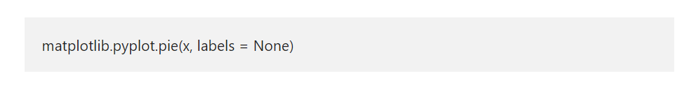
Python matplotlib Pie Chart
The Python matplotlib pie chart displays the series of data in slices or wedges, and each slice is the size of an item. In order to draw at the matplotlib chart in Python, you have to use the pyplot pie function. The syntax of this Python matplotlib pie function is

Slide 28
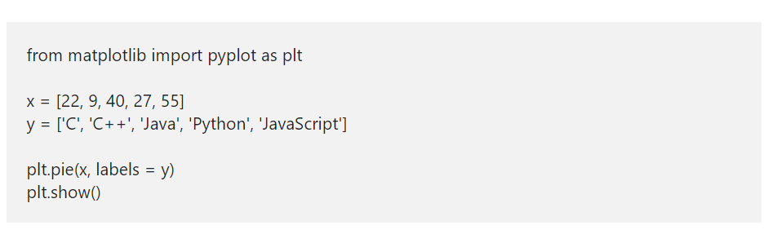
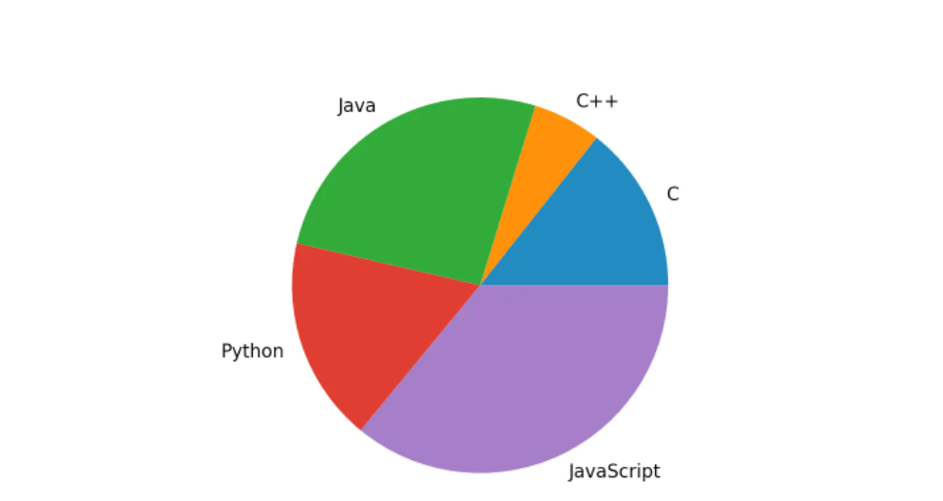
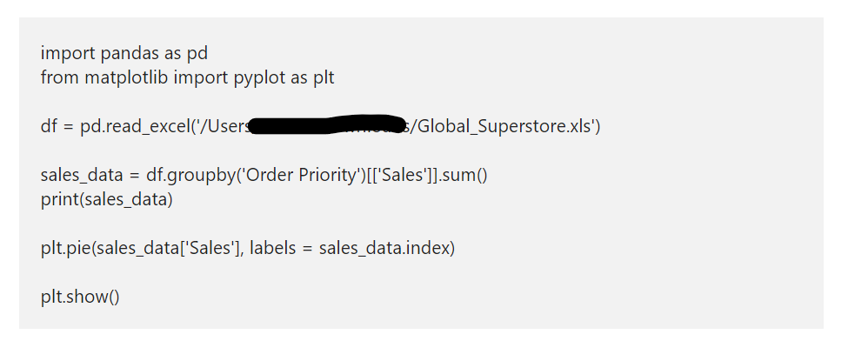
Python matplotlib Pie Chart Example

Slide 29
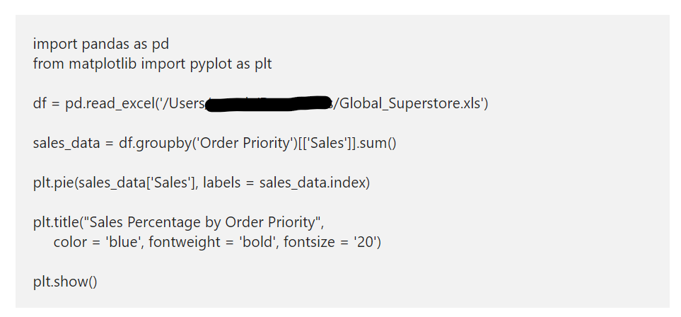
Add Title or Name to Pie Plot

Slide 30
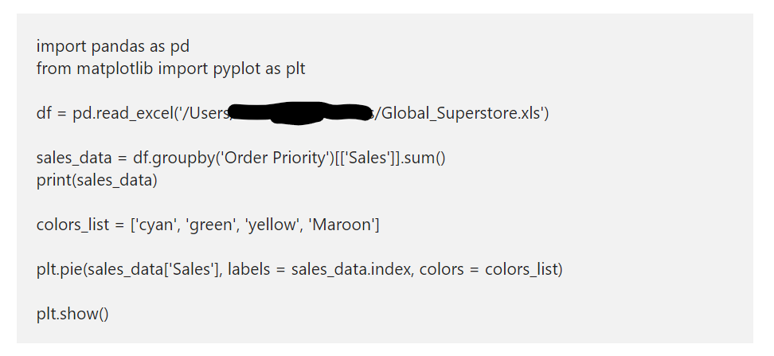
Change matplotlib Pie chart colors

Slide 31
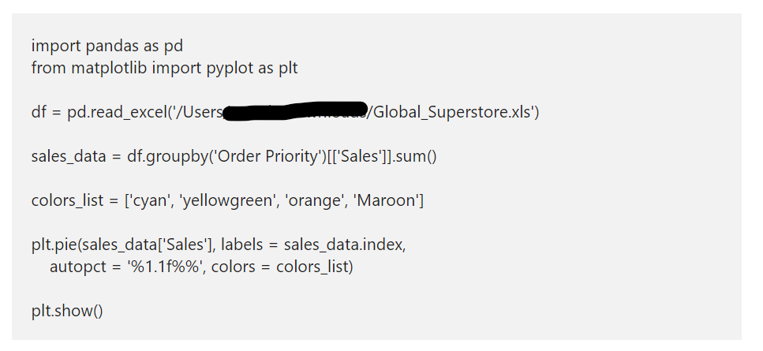
matplotlib Pie chart Percentage
The autopct argument shows the percentage of each slice in a matplotlib pie chart. Here, you can use the string format to vary the display of percentage values. For example, %1.2f%% returns value 25.34%, and .1f% returns 25.3%.

Slide 32
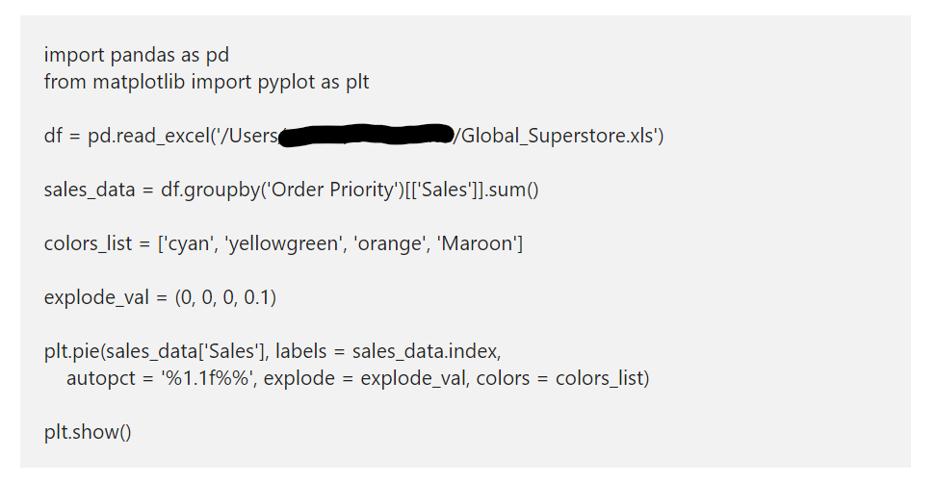
matplotlib Pie chart Slice out
The explode argument in pyplot decides which part should explode (separate and move a distance from the center). This argument accepts a tuple of numeric values, and each non-zero value represents the distance of that slice from the center. In this example, we exploded medium priority from the center.

Slide 33
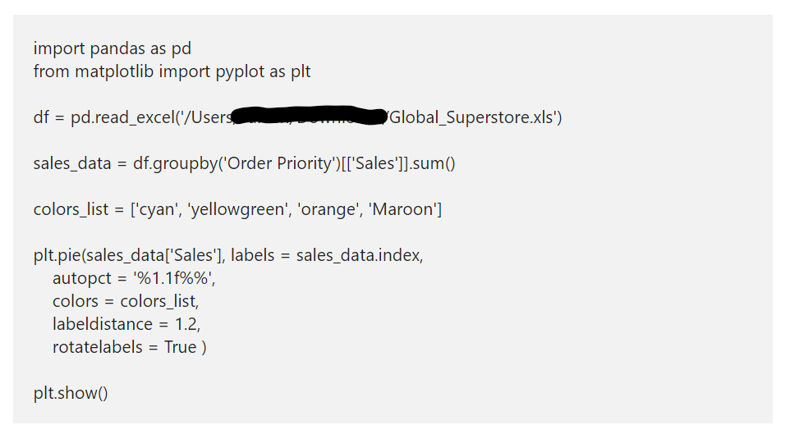
Format Pie Plot labels
The Python matplotlib pie chart rotatelabels arguments accept the boolean value, and its default value is False. If you specify true, then each label in it will be rotated to the corresponding slice angle. Next, the labeldistance argument accepts the float value. Here, you can specify the distance of the label from the actual chart or slice. In this example, we specified 1.2 as the distance, and you can notice the same in the output.

Slide 34
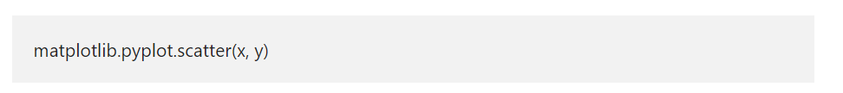
Python matplotlib Scatter Plot
The Python matplotlib scatter plot is a two dimensional graphical representation of the data. A Python scatter plot is useful to display the correlation between two numerical data values or two sets of data. In general, we use this Python matplotlib scatter plot to analyze the relationship between two numerical data points by drawing a regression line.
The matplotlib pyplot module has a function, which will draw or generate a scatter plot in Python. The basic syntax to draw matplotlib pyplot scatter plot is
x: list of arguments that represents the X-axis.
y: List of arguments represents Y-Axis.

Slide 35
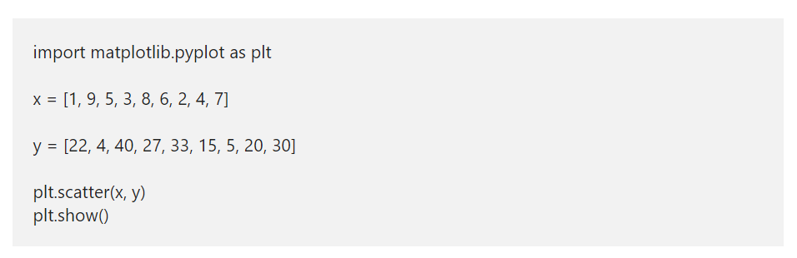
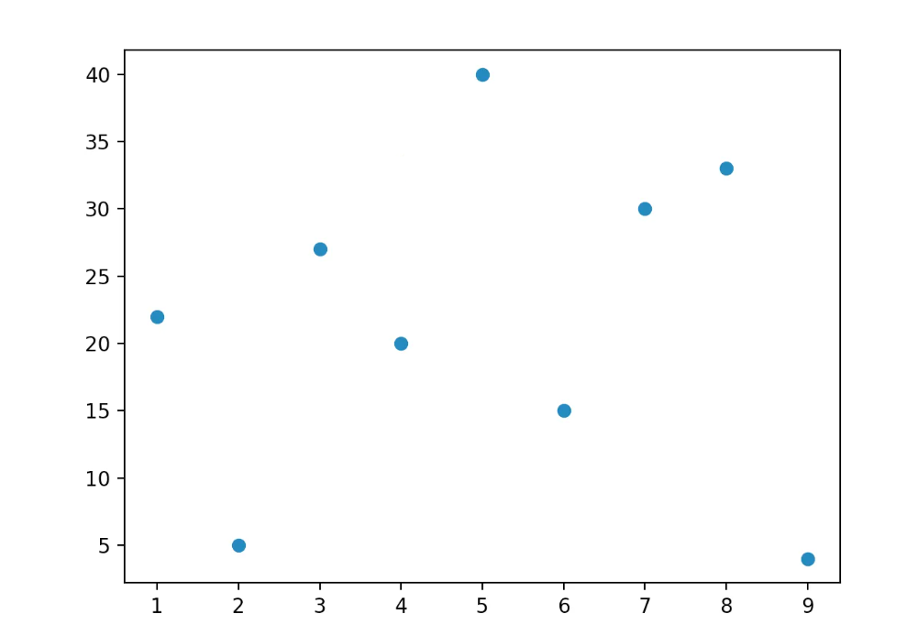
Python matplotlib Scatter Plot Examples

Slide 36
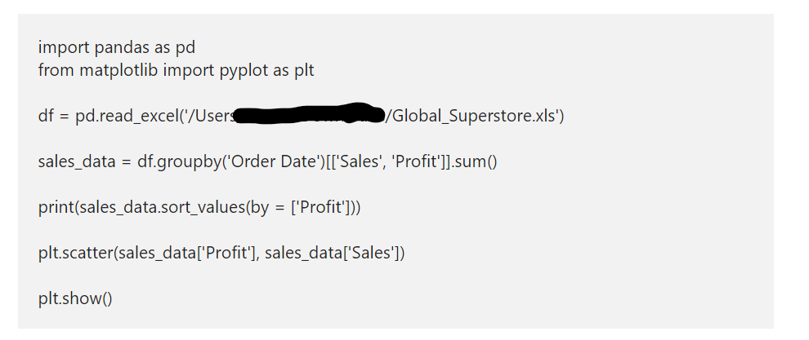
matplotlib Scatter Chart using CSV
In this example, we were reading the CSV file and converted it into DataFarme. Next, we are drawing a Python matplotlib scatter plot by using Profit in X-Axis and Sales in Y-Axis.

Slide 37
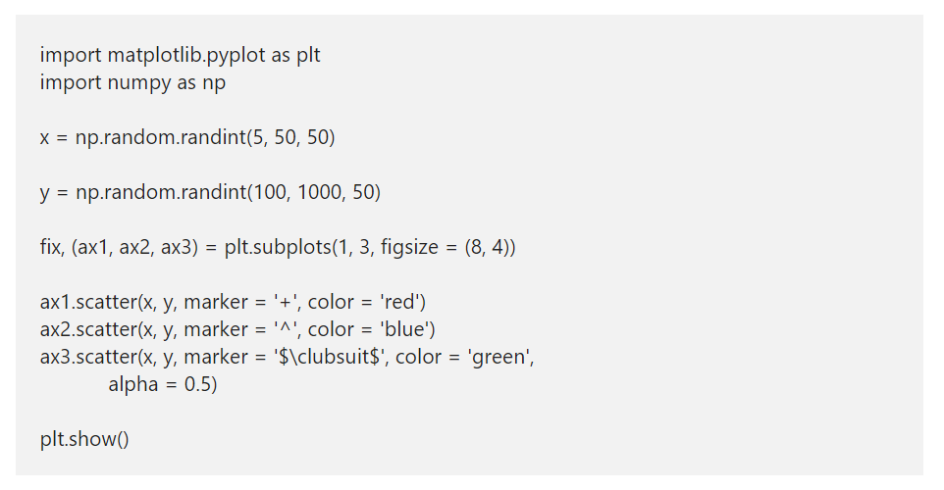
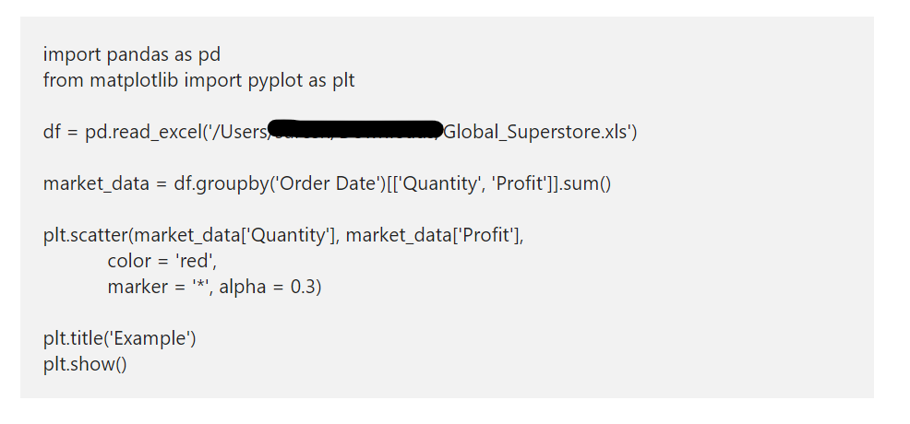
Python Scatter plot color and Marker

Slide 38
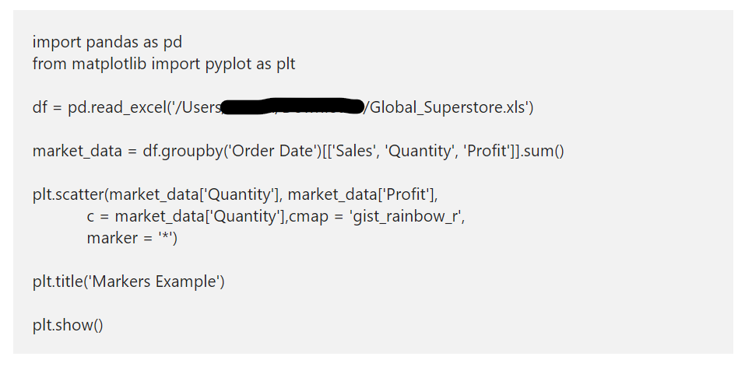
Python Scatter plot color and Marker

Slide 39
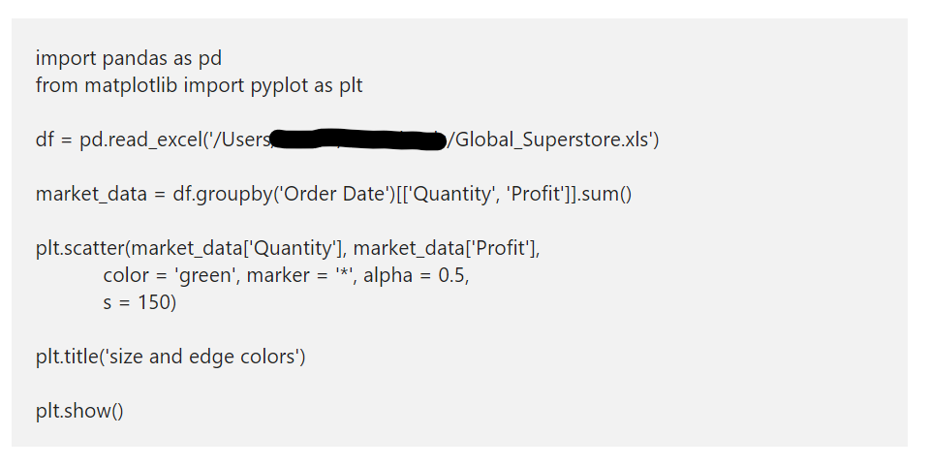
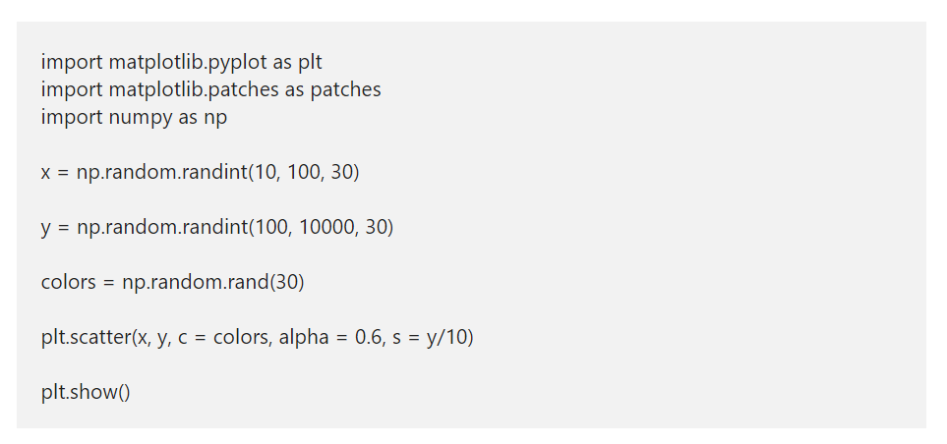
Python Scatter plot size and edge colors
The matplotlib scatter function has an s argument that defines the size of a marker. It accepts a static one value for all the markers or array like values. Here, we assigned 150 as a marker size, which means all the markers will size to that value.

Slide 40
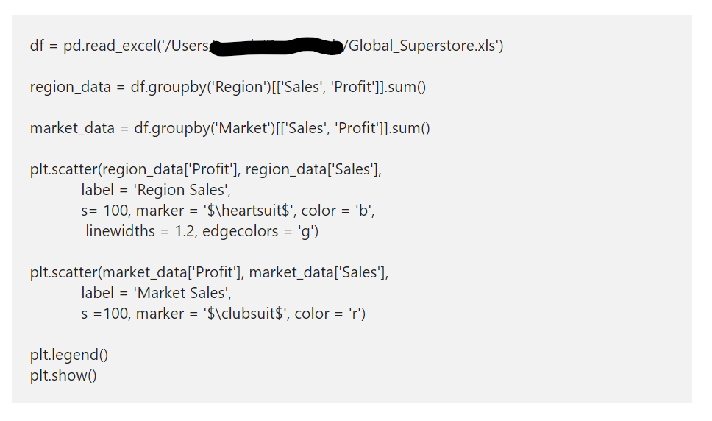
Add legend to Scatter Chart

Slide 41
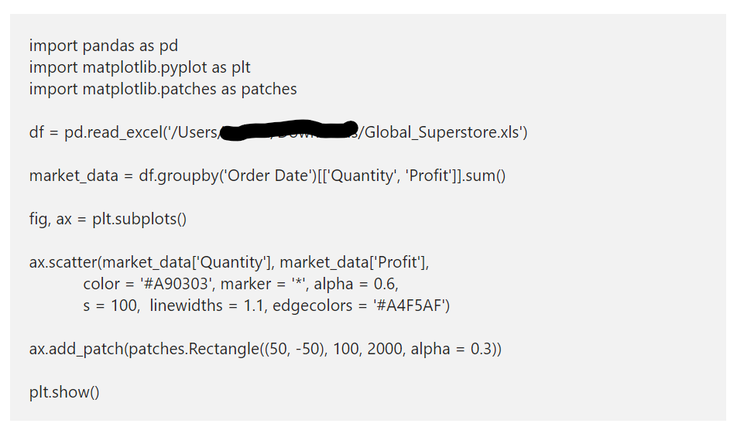
Highlight Area in a Python Scatter plot
In some situations, you might need to focus on a particular location or area within the Python scatter plot. So, you need to highlight that particular area for better focus. For this, all you need to do is add patches to an existing one. In this example, we are adding a rectangle to highlight the area.

